Slide 1
Job hunt 2022; a case review
Joaquín González; May, 2nd, 2022

Slide 2

Refers to the decisions of millions of workers to quit their jobs during the pandemic.
- Anthony Klotz¹

Slide 3

More info on the Great Resignation
World Economic Forum
Resignation rates are highest in the technology and healthcare industries²
The Future of Jobs Report 2020
Skills gaps continue to be high as in-demand skills […] such as:
Critical thinking and analysis
Problem-solving
Active learning
Resilience
Stress tolerance
Flexibility⁴
Age range: 30 – 45 years old
Harvard Business Review³
Notes:
Harvard Business Review
Employees between 30 and 45 years old have had the greatest increase in resignation rates, with an average increase of more than 20% between 2020 and 2021.³

Slide 4

Change?
What to do? Where to go?
Notes:
https://olbios.org/change-and-the-world-changes-with-you/ - Image source

Slide 5
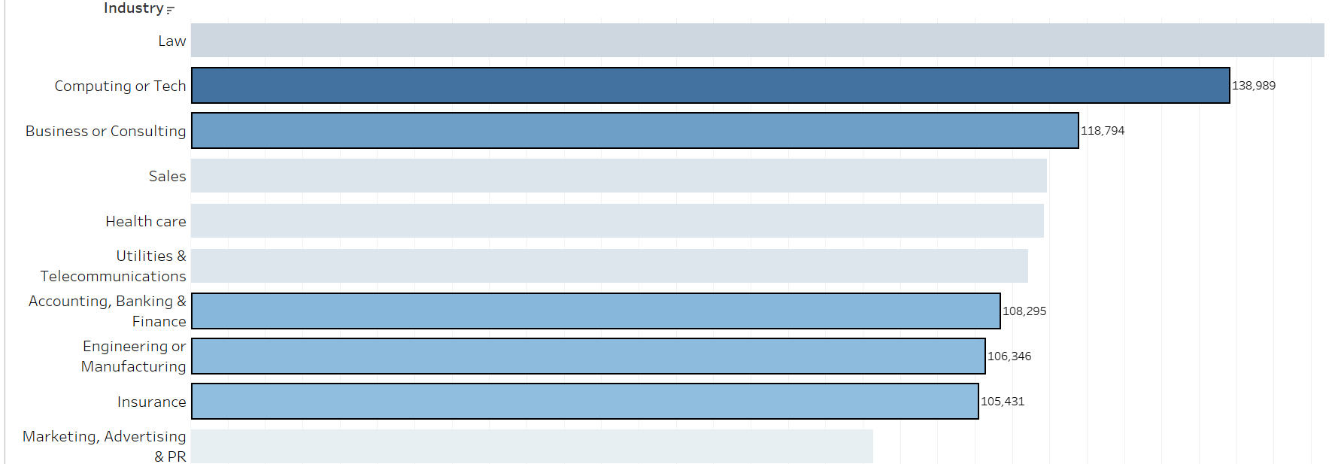
Top 10 Industries with highest annual salary per manager in USD⁵
Currently in training
My professional background

Slide 6
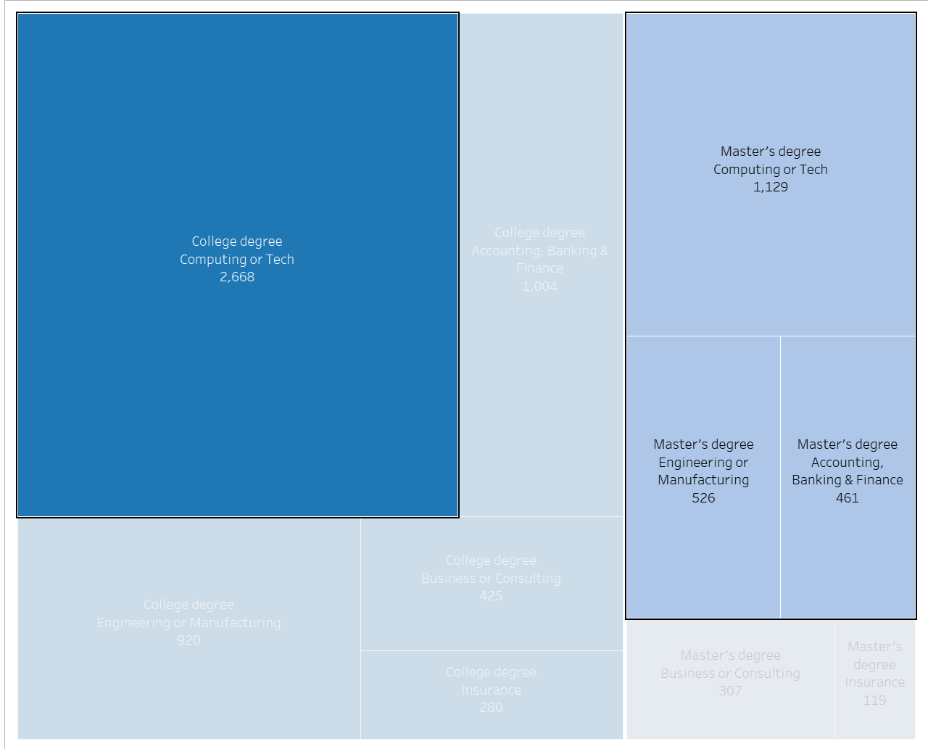
Exploit my academic background
Industry – Education Level⁵

Slide 7
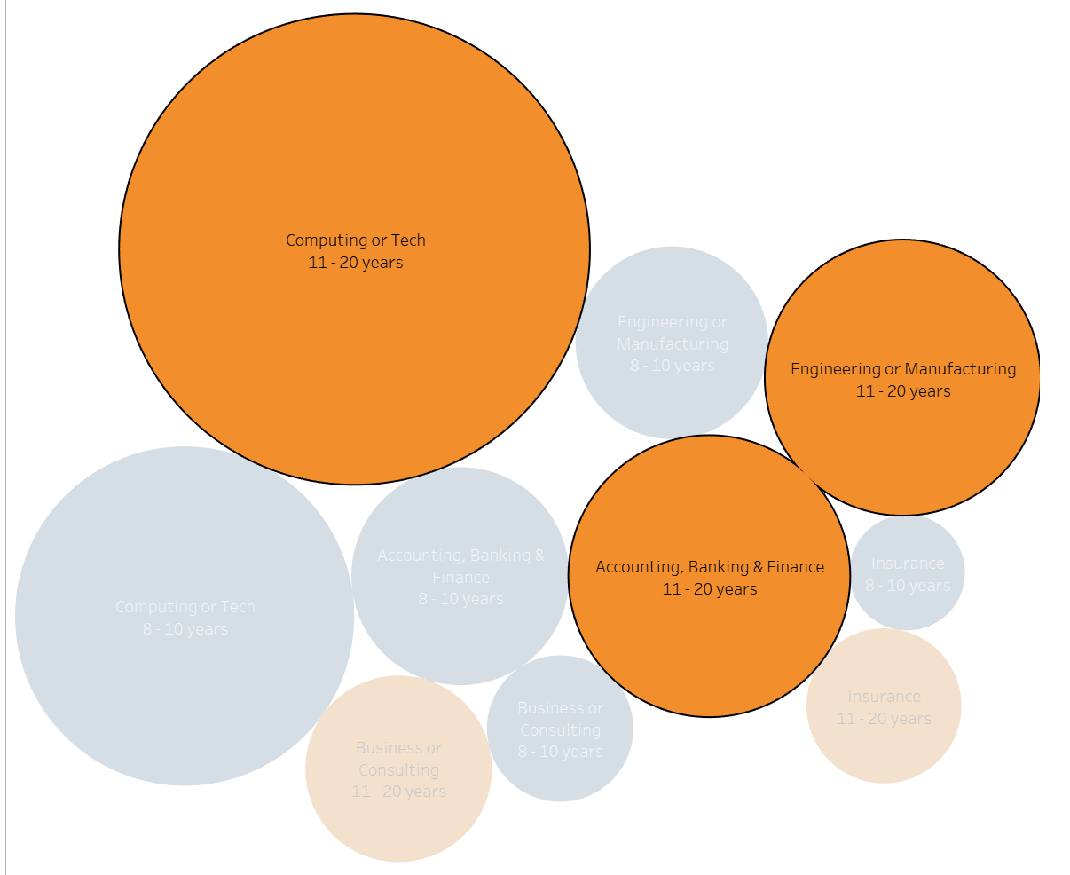
Supported by years of experience
Industry – Total years of experience⁵

Slide 8
Conclusion
Yellow
Is the color of gold, butter and ripe lemons. In the spectrum of visible light, yellow is found between green and orange.
Blue
Is the colour of the clear sky and the deep sea. It is located between violet and green on the optical spectrum.
Red
Is the color of blood, and because of this it has historically been associated with sacrifice, danger and courage.
Yellow
Is the color of gold, butter and ripe lemons. In the spectrum of visible light, yellow is found between green and orange.
Blue
Is the colour of the clear sky and the deep sea. It is located between violet and green on the optical spectrum.
Red
Is the color of blood, and because of this it has historically been associated with sacrifice, danger and courage.

Slide 9
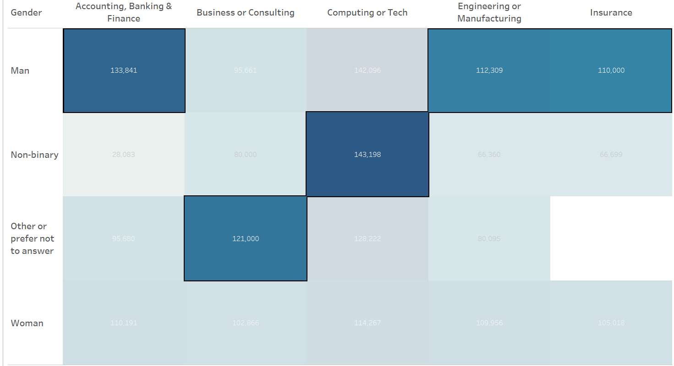
Competition: Salary differences by Gender
Salary by Industry – Gender⁵

Slide 10
Sources:
https://today.tamu.edu/2022/02/11/the-texas-am-professor-who-predicted-the-great-resignation/, extracted on Apr, 29th, 2022
https://www.weforum.org/agenda/2021/11/what-is-the-great-resignation-and-what-can-we-learn-from-it/, extracted on Apr, 29th, 2022
https://hbr.org/2021/09/who-is-driving-the-great-resignation, extracted on Apr, 29th, 2022
https://www.weforum.org/reports/the-future-of-jobs-report-2020/in-full/executive-summary, extracted on Apr, 29th, 2022
https://oscarbaruffa.com/messy/, Database: 'Ask A Manager Salary Survey 2021 (Responses)' downloaded on April, 20th, 2022

